Slide 2
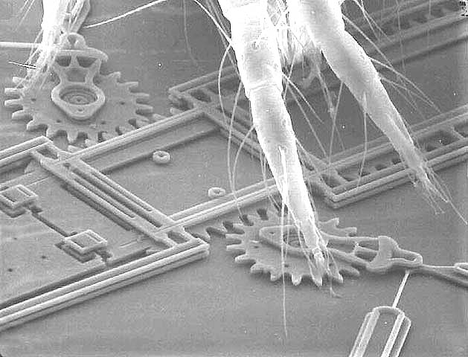
Bugs on MEMS
This was made using a surface micromachining technology featuring four mechanical layers of polysilicon.
Courtesy Sandia National Laboratories, SUMMiT™ Technologies, www.sandia.gov/mstc

